Slide 1
Python for Data Analysis

Slide 2
Python Libraries for Data Science
Many popular Python toolboxes/libraries:
NumPy
SciPy
Pandas
SciKit-Learn
Visualization libraries
matplotlib
Seaborn
and many more …
All these libraries are installed on the SCC

Slide 3

Python Libraries for Data Science
NumPy:
introduces objects for multidimensional arrays and matrices, as well as functions that allow to easily perform advanced mathematical and statistical operations on those objects
provides vectorization of mathematical operations on arrays and matrices which significantly improves the performance
many other python libraries are built on NumPy
Link: http://www.numpy.org/

Slide 4

Python Libraries for Data Science
SciPy:
collection of algorithms for linear algebra, differential equations, numerical integration, optimization, statistics and more
part of SciPy Stack
built on NumPy
Link: https://www.scipy.org/scipylib/

Slide 5

Python Libraries for Data Science
Pandas:
adds data structures and tools designed to work with table-like data (similar to Series and Data Frames in R)
provides tools for data manipulation: reshaping, merging, sorting, slicing, aggregation etc.
allows handling missing data
Link: http://pandas.pydata.org/

Slide 6

Python Libraries for Data Science
SciKit-Learn:
provides machine learning algorithms: classification, regression, clustering, model validation etc.
built on NumPy, SciPy and matplotlib
Link: http://scikit-learn.org/

Slide 7

Python Libraries for Data Science
matplotlib:
python 2D plotting library which produces publication quality figures in a variety of hardcopy formats
a set of functionalities similar to those of MATLAB
line plots, scatter plots, barcharts, histograms, pie charts etc.
relatively low-level; some effort needed to create advanced visualization
Link: https://matplotlib.org/

Slide 8
Python Libraries for Data Science
Seaborn:
based on matplotlib
provides high level interface for drawing attractive statistical graphics
Similar (in style) to the popular ggplot2 library in R
Link: https://seaborn.pydata.org/

Slide 9
Download tutorial notebook
# On the Shared Computing Cluster
[scc1 ~] cp /project/scv/examples/python/data_analysis/dataScience.ipynb .
# On a local computer save the link:
http://rcs.bu.edu/examples/python/data_analysis/dataScience.ipynb

Slide 10
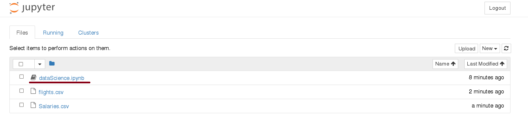
Start Jupyter nootebook
# On the Shared Computing Cluster
[scc1 ~] jupyter notebook

Slide 11
Loading Python Libraries
In [ ]:
#Import Python Libraries
import numpy as np
import scipy as sp
import pandas as pd
import matplotlib as mpl
import seaborn as sns
Press Shift+Enter to execute the jupyter cell

Slide 12
Reading data using pandas
In [ ]:
#Read csv file
df = pd.read_csv("http://rcs.bu.edu/examples/python/data_analysis/Salaries.csv")
Note: The above command has many optional arguments to fine-tune the data import process.
There is a number of pandas commands to read other data formats:
pd.read_excel('myfile.xlsx',sheet_name='Sheet1', index_col=None, na_values=['NA'])
pd.read_stata('myfile.dta')
pd.read_sas('myfile.sas7bdat')
pd.read_hdf('myfile.h5','df')

Slide 13
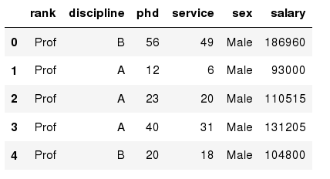
Exploring data frames
In [3]:
#List first 5 records
df.head()
Out[3]:

Slide 14

Hands-on exercises
Try to read the first 10, 20, 50 records;
Can you guess how to view the last few records; Hint:

Slide 15
Data Frame data types
Pandas Type | Native Python Type | Description
object | string | The most general dtype. Will be assigned to your column if column has mixed types (numbers and strings).
int64 | int | Numeric characters. 64 refers to the memory allocated to hold this character.
float64 | float | Numeric characters with decimals. If a column contains numbers and NaNs(see below), pandas will default to float64, in case your missing value has a decimal.
datetime64, timedelta[ns] | N/A (but see the datetime module in Python’s standard library) | Values meant to hold time data. Look into these for time series experiments.

Slide 16
Data Frame data types
In [4]:
#Check a particular column type
df['salary'].dtype
Out[4]: dtype('int64')
In [5]:
#Check types for all the columns
df.dtypes
Out[4]:
object
object
int64
int64
object
int64
rank
discipline
phd
service
sex
salary
dtype: object

Slide 17
Data Frames attributes
Python objects have attributes and methods.
df.attribute | description
dtypes | list the types of the columns
columns | list the column names
axes | list the row labels and column names
ndim | number of dimensions
size | number of elements
shape | return a tuple representing the dimensionality
values | numpy representation of the data

Slide 18
Hands-on exercises
Find how many records this data frame has;
How many elements are there?
What are the column names?
What types of columns we have in this data frame?

Slide 19
Data Frames methods
Unlike attributes, python methods have parenthesis.
All attributes and methods can be listed with a dir() function: dir(df)
df.method() | description
head( [n] ), tail( [n] ) | first/last n rows
describe() | generate descriptive statistics (for numeric columns only)
max(), min() | return max/min values for all numeric columns
mean(), median() | return mean/median values for all numeric columns
std() | standard deviation
sample([n]) | returns a random sample of the data frame
dropna() | drop all the records with missing values

Slide 20
Hands-on exercises
Give the summary for the numeric columns in the dataset
Calculate standard deviation for all numeric columns;
What are the mean values of the first 50 records in the dataset? Hint: use head() method to subset the first 50 records and then calculate the mean

Slide 21
Selecting a column in a Data Frame
Method 1: Subset the data frame using column name:
df['sex']
Method 2: Use the column name as an attribute:
df.sex
Note: there is an attribute rank for pandas data frames, so to select a column with a name "rank" we should use method 1.

Slide 22
Hands-on exercises
Calculate the basic statistics for the salary column;
Find how many values in the salary column (use count method);
Calculate the average salary;

Slide 23
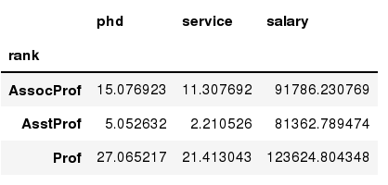
Data Frames groupby method
Using "group by" method we can:
Split the data into groups based on some criteria
Calculate statistics (or apply a function) to each group
Similar to dplyr() function in R
In [ ]:
#Group data using rank
df_rank = df.groupby(['rank'])
In [ ]:
#Calculate mean value for each numeric column per each group
df_rank.mean()

Slide 24
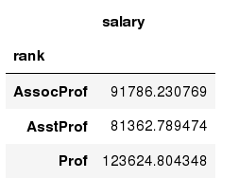
Data Frames groupby method
Once groupby object is create we can calculate various statistics for each group:
In [ ]:
#Calculate mean salary for each professor rank:
df.groupby('rank')[['salary']].mean()
Note: If single brackets are used to specify the column (e.g. salary), then the output is Pandas Series object. When double brackets are used the output is a Data Frame

Slide 25
Data Frames groupby method
groupby performance notes:
- no grouping/splitting occurs until it's needed. Creating the groupby object only verifies that you have passed a valid mapping
- by default the group keys are sorted during the groupby operation. You may want to pass sort=False for potential speedup:
In [ ]:
#Calculate mean salary for each professor rank:
df.groupby(['rank'], sort=False)[['salary']].mean()

Slide 26
Data Frame: filtering
To subset the data we can apply Boolean indexing. This indexing is commonly known as a filter. For example if we want to subset the rows in which the salary value is greater than $120K:
In [ ]:
#Calculate mean salary for each professor rank:
df_sub = df[ df['salary'] > 120000 ]
Any Boolean operator can be used to subset the data:
> greater; >= greater or equal;
< less; <= less or equal;
== equal; != not equal;
In [ ]:
#Select only those rows that contain female professors:
df_f = df[ df['sex'] == 'Female' ]

Slide 27
Data Frames: Slicing
There are a number of ways to subset the Data Frame:
one or more columns
one or more rows
a subset of rows and columns
Rows and columns can be selected by their position or label

Slide 28
Data Frames: Slicing
When selecting one column, it is possible to use single set of brackets, but the resulting object will be a Series (not a DataFrame):
In [ ]:
#Select column salary:
df['salary']
When we need to select more than one column and/or make the output to be a DataFrame, we should use double brackets:
In [ ]:
#Select column salary:
df[['rank','salary']]

Slide 29
Data Frames: Selecting rows
If we need to select a range of rows, we can specify the range using ":"
In [ ]:
#Select rows by their position:
df[10:20]
Notice that the first row has a position 0, and the last value in the range is omitted:
So for 0:10 range the first 10 rows are returned with the positions starting with 0 and ending with 9

Slide 30
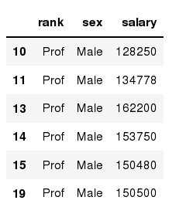
Data Frames: method loc
If we need to select a range of rows, using their labels we can use method loc:
In [ ]:
#Select rows by their labels:
df_sub.loc[10:20,['rank','sex','salary']]
Out[ ]:

Slide 31
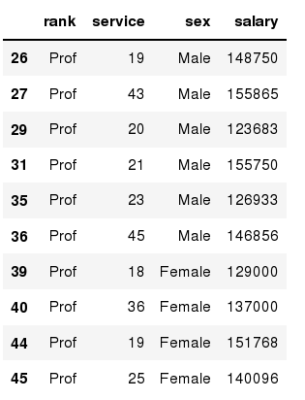
Data Frames: method iloc
If we need to select a range of rows and/or columns, using their positions we can use method iloc:
In [ ]:
#Select rows by their labels:
df_sub.iloc[10:20,[0, 3, 4, 5]]
Out[ ]:

Slide 32
Data Frames: method iloc (summary)
df.iloc[0] # First row of a data frame
df.iloc[i] #(i+1)th row
df.iloc[-1] # Last row
df.iloc[:, 0] # First column
df.iloc[:, -1] # Last column
df.iloc[0:7] #First 7 rows
df.iloc[:, 0:2] #First 2 columns
df.iloc[1:3, 0:2] #Second through third rows and first 2 columns
df.iloc[[0,5], [1,3]] #1st and 6th rows and 2nd and 4th columns

Slide 33
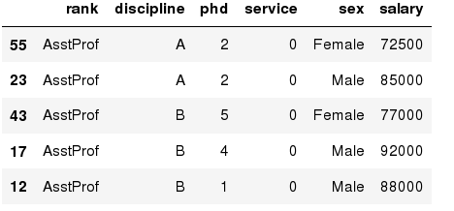
Data Frames: Sorting
We can sort the data by a value in the column. By default the sorting will occur in ascending order and a new data frame is return.
In [ ]:
# Create a new data frame from the original sorted by the column Salary
df_sorted = df.sort_values( by ='service')
df_sorted.head()
Out[ ]:

Slide 34
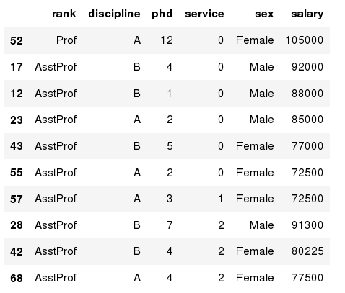
Data Frames: Sorting
We can sort the data using 2 or more columns:
In [ ]:
df_sorted = df.sort_values( by =['service', 'salary'], ascending = [True, False])
df_sorted.head(10)
Out[ ]:

Slide 35
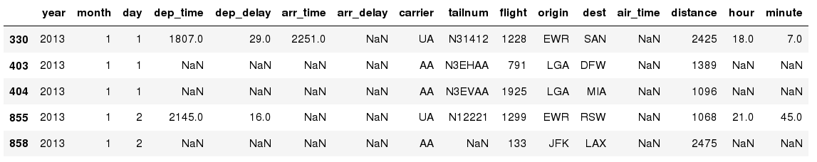
Missing Values
Missing values are marked as NaN
In [ ]:
# Read a dataset with missing values
flights = pd.read_csv("http://rcs.bu.edu/examples/python/data_analysis/flights.csv")
In [ ]:
# Select the rows that have at least one missing value
flights[flights.isnull().any(axis=1)].head()
Out[ ]:

Slide 36
Missing Values
There are a number of methods to deal with missing values in the data frame:
df.method() | description
dropna() | Drop missing observations
dropna(how='all') | Drop observations where all cells is NA
dropna(axis=1, how='all') | Drop column if all the values are missing
dropna(thresh = 5) | Drop rows that contain less than 5 non-missing values
fillna(0) | Replace missing values with zeros
isnull() | returns True if the value is missing
notnull() | Returns True for non-missing values

Slide 37
Missing Values
When summing the data, missing values will be treated as zero
If all values are missing, the sum will be equal to NaN
cumsum() and cumprod() methods ignore missing values but preserve them in the resulting arrays
Missing values in GroupBy method are excluded (just like in R)
Many descriptive statistics methods have skipna option to control if missing data should be excluded . This value is set to True by default (unlike R)

Slide 38
Aggregation Functions in Pandas
Aggregation - computing a summary statistic about each group, i.e.
compute group sums or means
compute group sizes/counts
Common aggregation functions:
min, max
count, sum, prod
mean, median, mode, mad
std, var

Slide 39
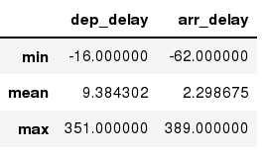
Aggregation Functions in Pandas
agg() method are useful when multiple statistics are computed per column:
In [ ]:
flights[['dep_delay','arr_delay']].agg(['min','mean','max'])
Out[ ]:

Slide 40
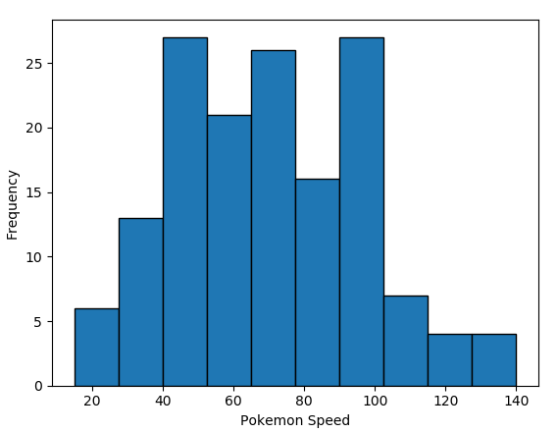

Plotting a histogram in Python

Slide 41
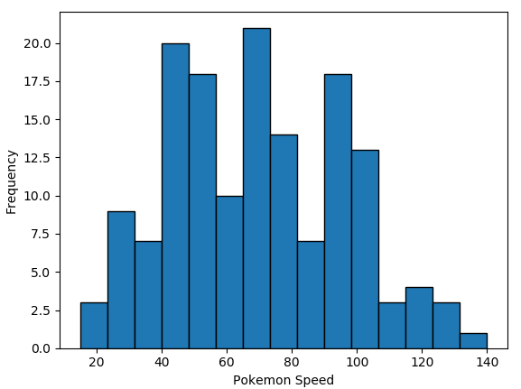
Bins
You may have noticed the two histograms we’ve seen so far look different, despite using the exact same data.
This is because they have different bin values.
The left graph used the default bins generated by plt.hist(), while the one on the right used bins that I specified.

Slide 42

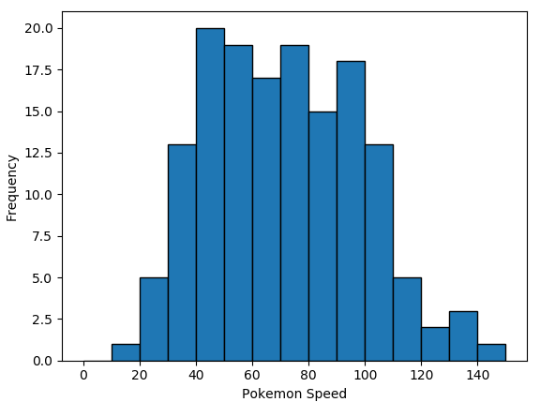
There are a couple of ways to manipulate bins in matplotlib.
Here, I specified where the edges of the bars of the histogram are; the bin edges.

Slide 43

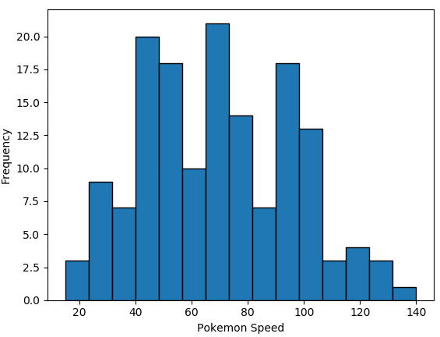
You could also specify the number of bins, and Matplotlib will automatically generate a number of evenly spaced bins.

Slide 44
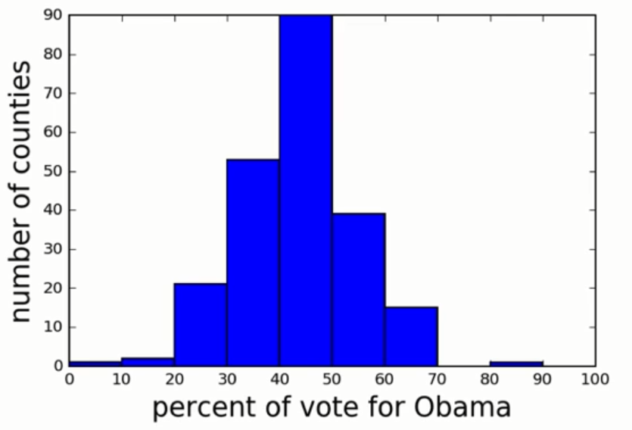
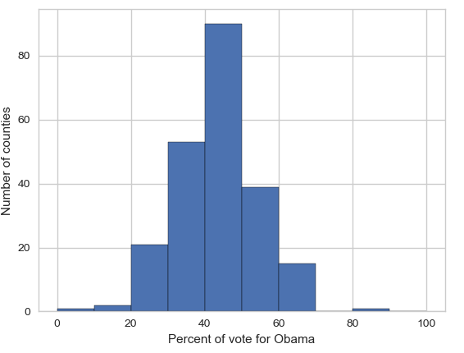
Seaborn
Matplotlib is a powerful, but sometimes unwieldy, Python library.
Seaborn provides a high-level interface to Matplotlib and makes it easier to produce graphs like the one on the right.
Some IDEs incorporate elements of this “under the hood” nowadays.

Slide 45
Benefits of Seaborn
Seaborn offers:
- Using default themes that are aesthetically pleasing.
- Setting custom colour palettes.
- Making attractive statistical plots.
- Easily and flexibly displaying distributions.
- Visualising information from matrices and DataFrames.
The last three points have led to Seaborn becoming the exploratory data analysis tool of choice for many Python users.

Slide 46
Plotting with Seaborn
One of Seaborn's greatest strengths is its diversity of plotting functions.
Most plots can be created with one line of code.
For example….

Slide 47
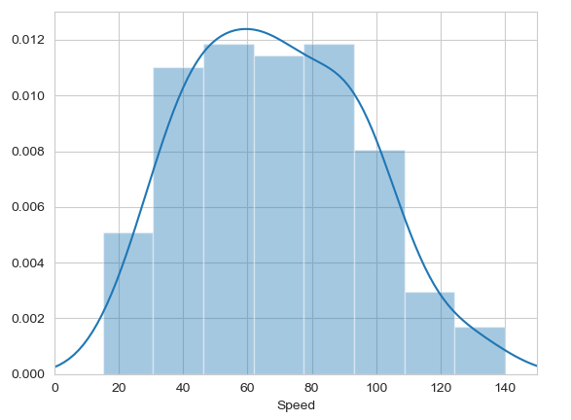

Histograms
Allow you to plot the distributions of numeric variables.

Slide 48
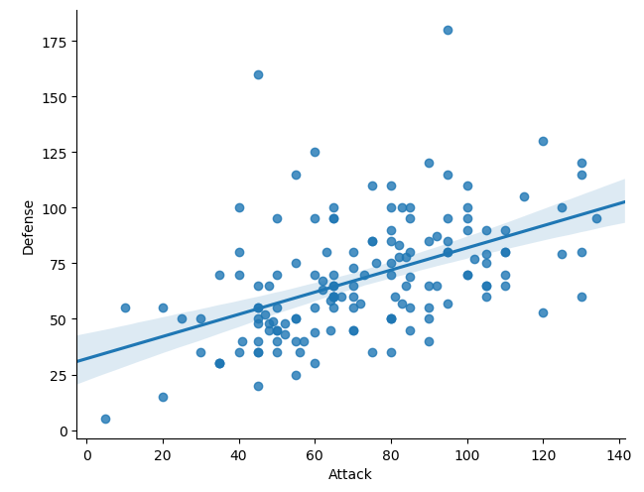
Other types of graphs: Creating a scatter plot
Name of our dataframe fed to the “data=“ command
Name of variable we want on the x-axis
Seaborn “linear model plot” function for creating a scatter graph
Name of variable we want on the y-axis

Slide 49
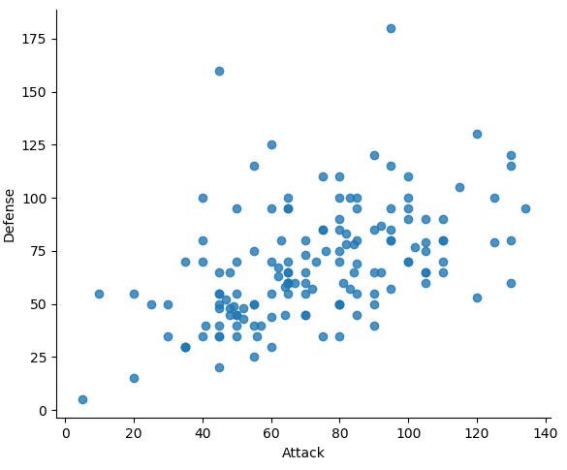
Seaborn doesn't have a dedicated scatter plot function.
We used Seaborn's function for fitting and plotting a regression line; hence lmplot()
However, Seaborn makes it easy to alter plots.
To remove the regression line, we use the fit_reg=False command

Slide 50
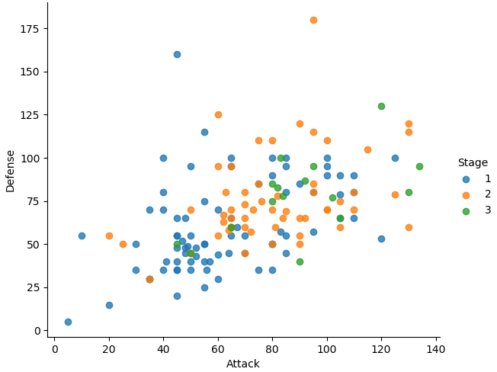

The hue function
Another useful function in Seaborn is the hue function, which enables us to use a variable to colour code our data points.

Slide 51
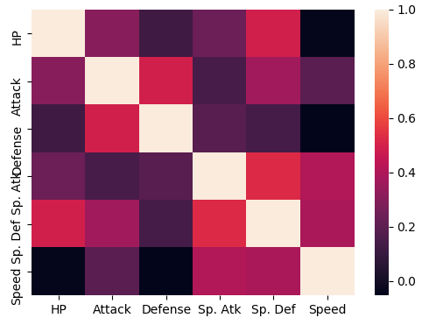

Heatmaps
Useful for visualising matrix-like data.
Here, we’ll plot the correlation of the stats_df variables

Slide 52
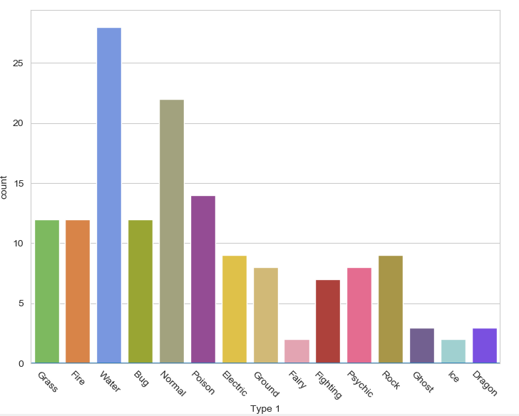

Bar plot
Visualises the distributions of categorical variables.
Rotates the x-ticks 45 degrees

Slide 53
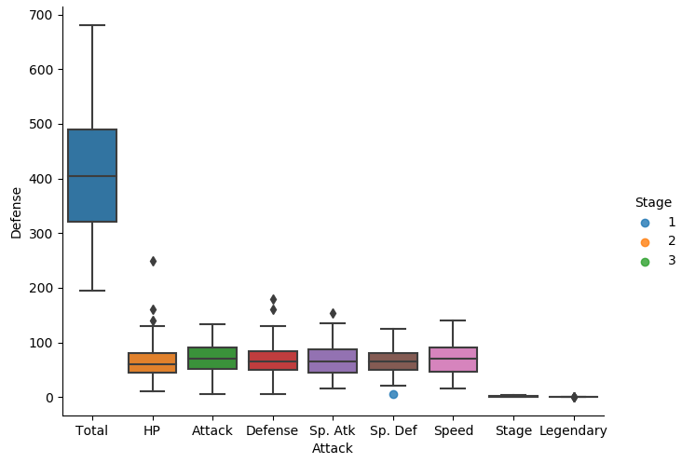

A box plot

Slide 54
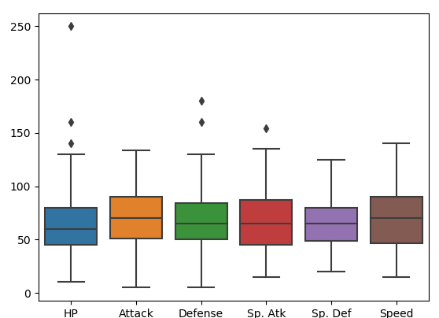
The total, stage, and legendary entries are not combat stats so we should remove them.
Pandas makes this easy to do, we just create a new dataframe
We just use Pandas’ .drop() function to create a dataframe that doesn’t include the variables we don’t want.

Slide 55
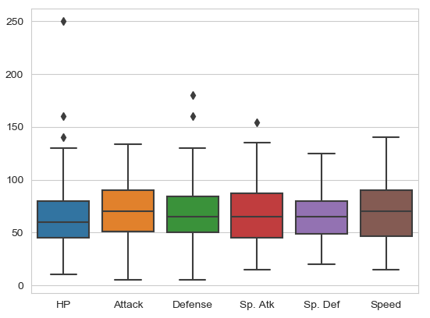

Seaborn’s theme
Seaborn has a number of themes you can use to alter the appearance of plots.
For example, we can use “whitegrid” to add grid lines to our boxplot.

Slide 56
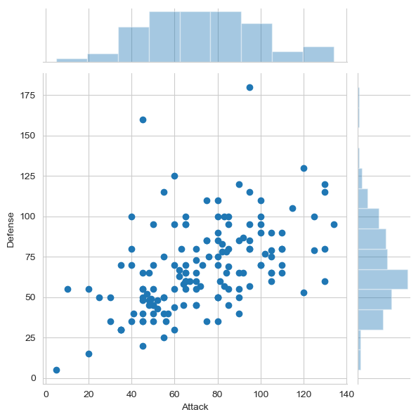

Joint Distribution Plot
Joint distribution plots combine information from scatter plots and histograms to give you detailed information for bi-variate distributions.

Slide 57
Any questions?

